Slide 1

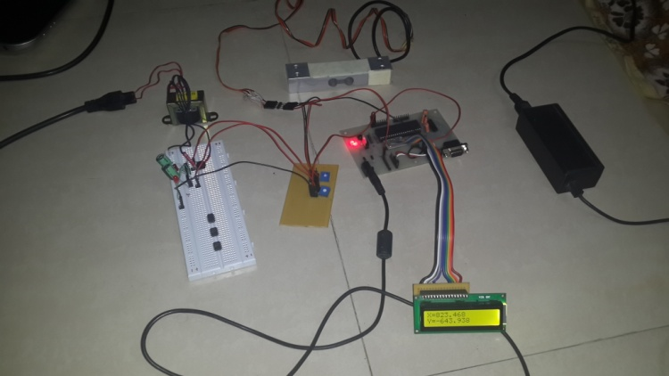
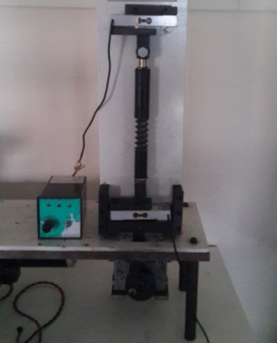
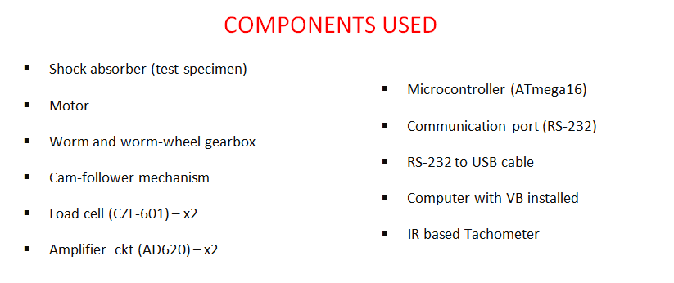
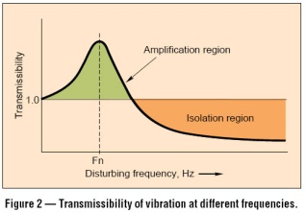
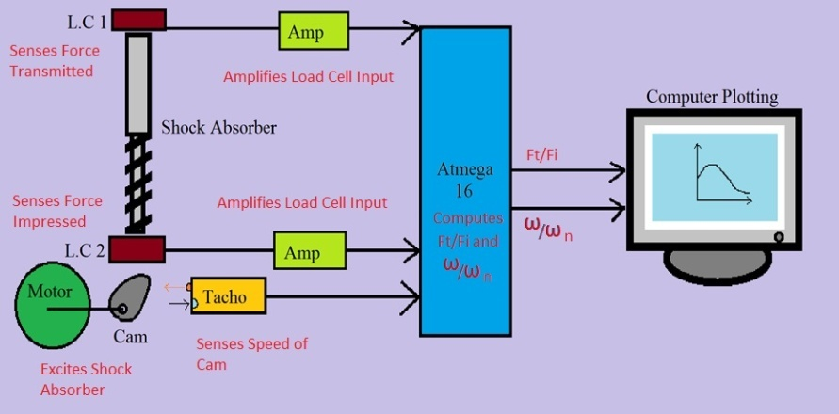
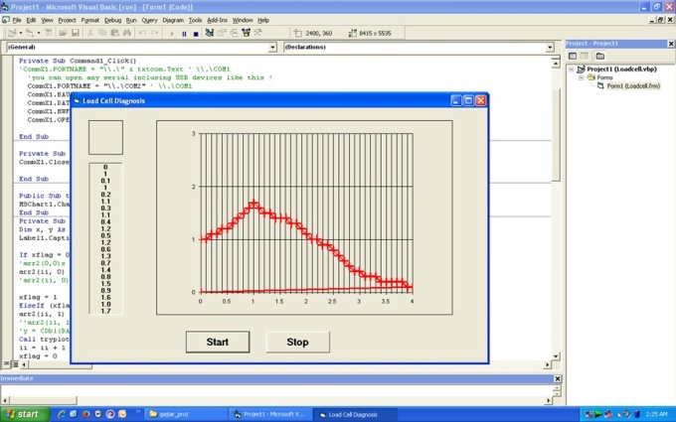
Performance Analysis of Shock-Absorber Using Test-rig
A Final Year (B.E.) Project by:
Aanand Gajjar
Pranav Pishawikar
Debjyoti Mazumdar
Project Guide:
Prof. P.P. Hujare
H.O.D:
Prof. S.C. Shilwant
Department of Mechanical Engineering,
Sinhgad Academy of Engineering (Kondhwa), Pune.
ABSTRACT
Shock-absorbers are prone to wear over prolonged usage. Usual method to test a shock-absorber is for a mechanic to push down on the vehicle’s hood or trunk and watch the dynamic response when the force is abruptly removed. However, his process is highly objective.
Our setup enables quantitative measurement of dynamic response of a vehicle’s suspension system and put an objective basis behind the decision of when to replace shock absorbers and struts.
We have utilized simple and economical components and USB-interfacing, with the real-time output being displayed on a widely-used industrial software platform, Visual Basic.
EXPERIMENTAL SETUP
THEORY
The main objective of the system is to plot the Transmissibility vs. Frequency Ratio curve at various damping conditions as well as amplitudes.
Transmissibility (T_{r}) is the ratio of the force transmitted to the supporting structure or foundation (F_{t}), to the force impressed upon the system (F_{o}).
SIMPLIFIED LAYOUT AND WORKING
RESULTS
CONCLUSION
We have thus successfully developed a system that can easily standardize the testing of shock absorbers. Using such a system, we can easily compare the practical and theoretical values of damping factor to give definitive assessments as to when the shock absorbers need replacement.
CONCLUSION
We have thus successfully developed a system that can easily standardize the testing of shock absorbers. Using such a system, we can easily compare the practical and theoretical values of damping factor to give definitive assessments as to when the shock absorbers need replacement.

